Slide 1
NCI update
12 12 2023
Ty Bottorff

Slide 2
Outline
irAE introduction
Crossreactive T cell hypothesis
Methods
Preliminary results
Next steps

Slide 3
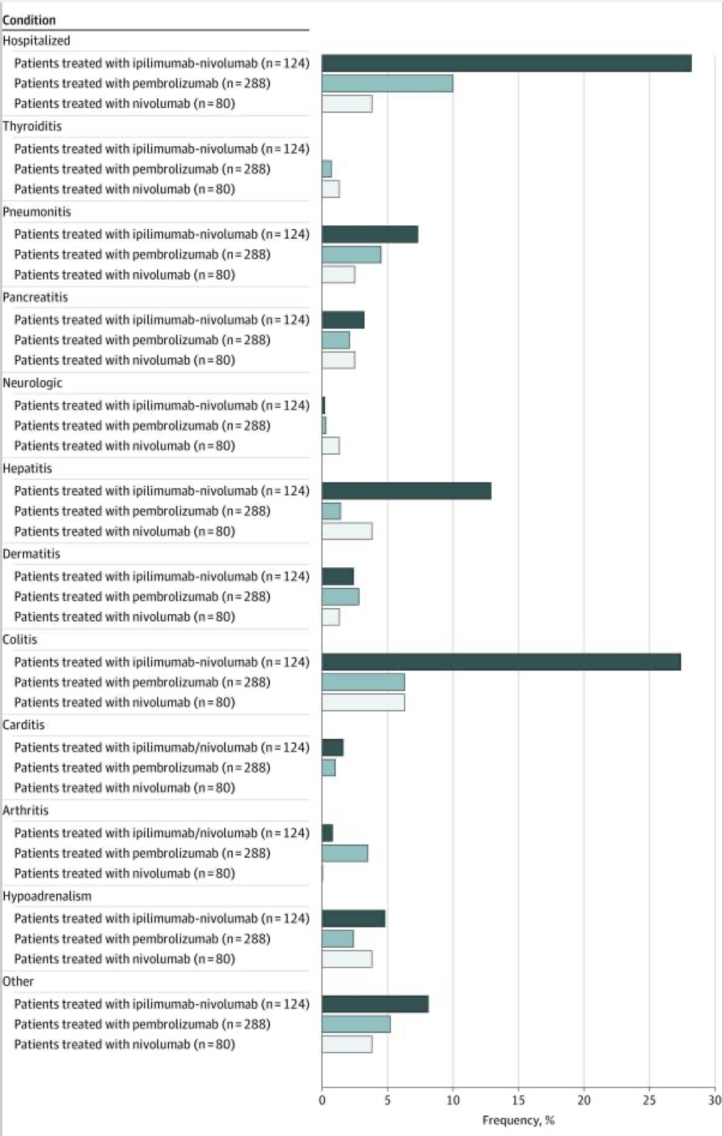
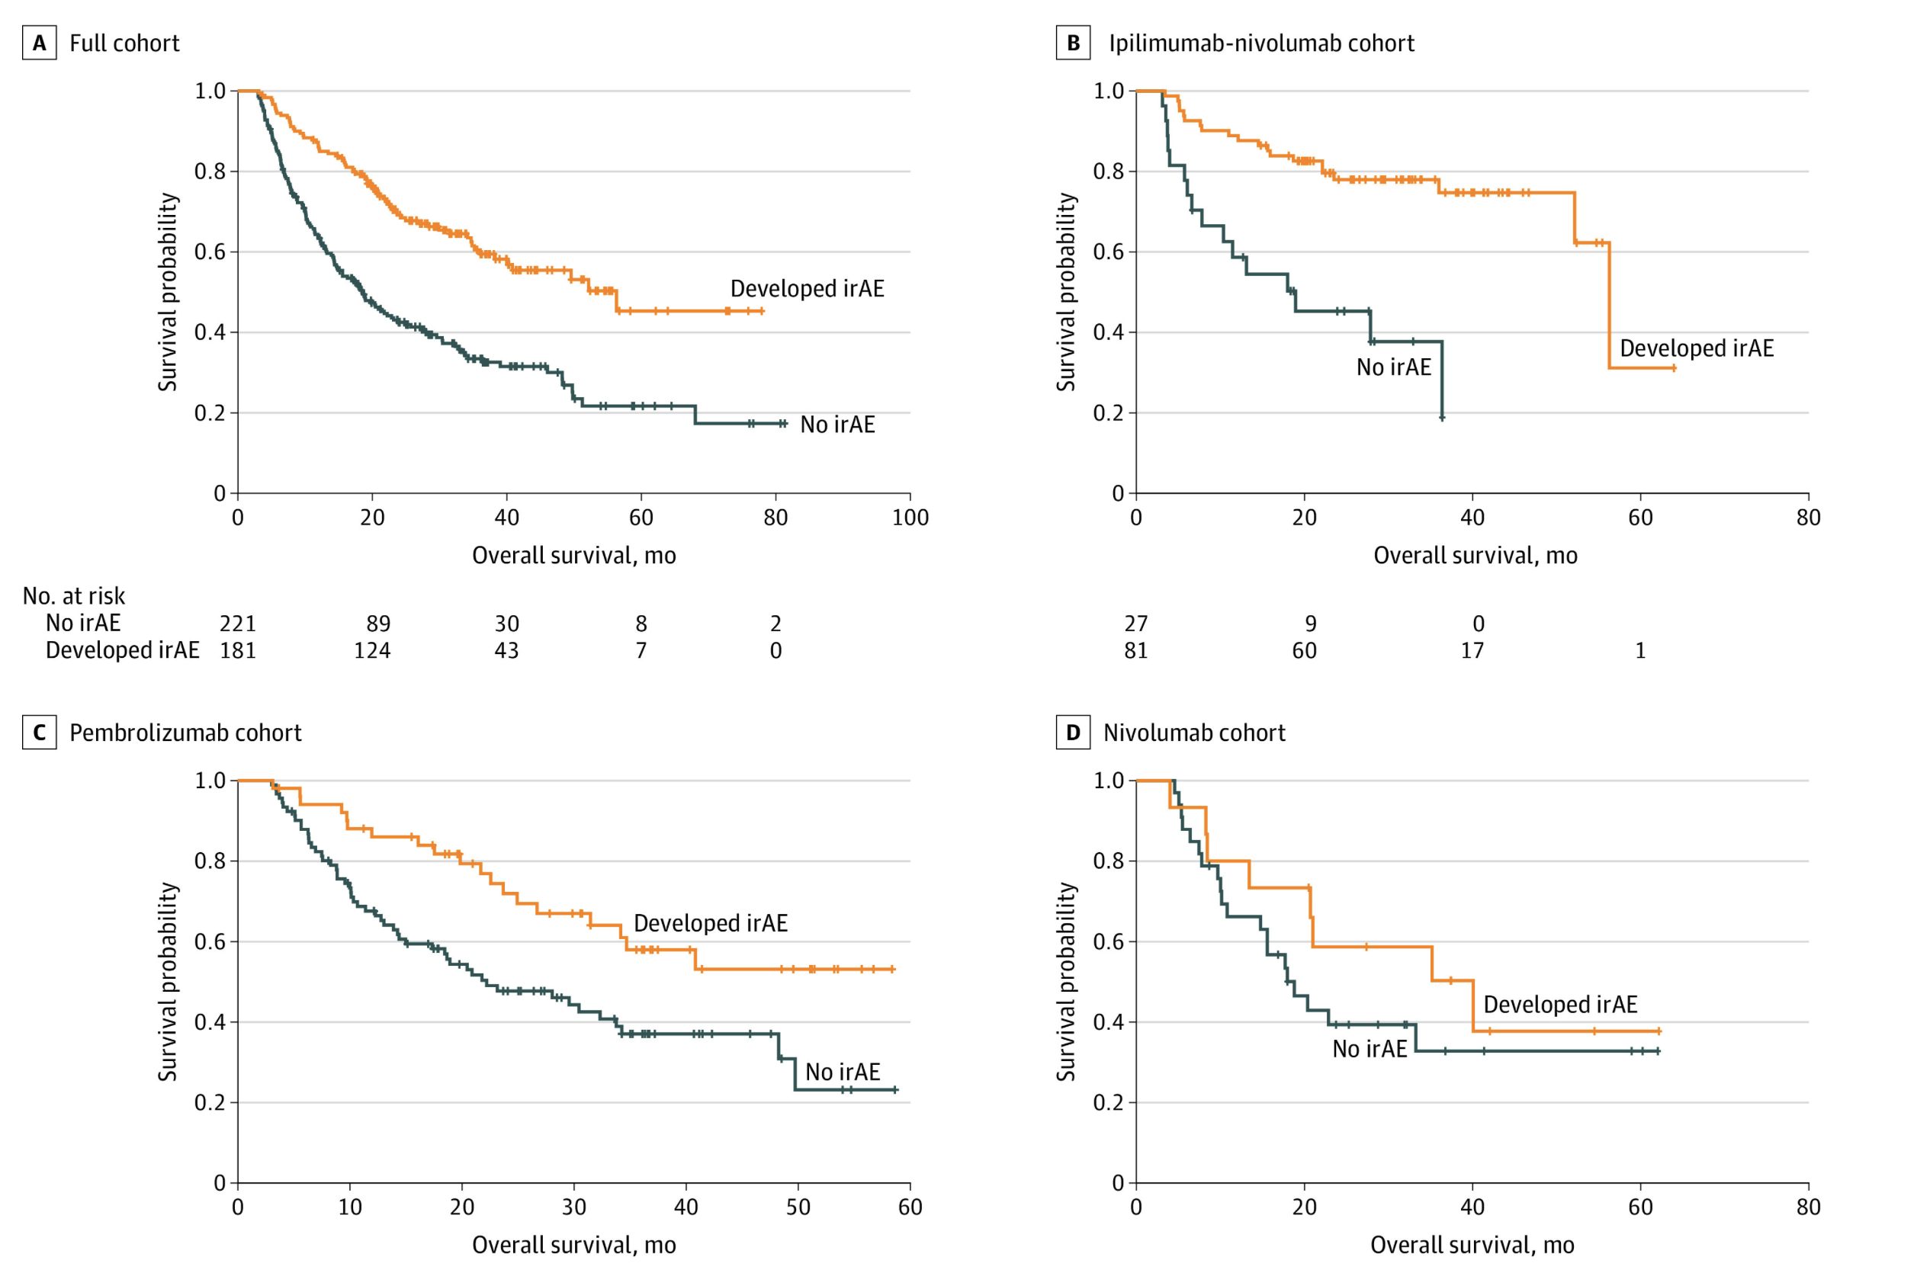
Immune-related adverse events (irAEs) from ICB are common and generally associated with anti-tumor response
Notes:
Ipilimumab: CTLA-4
Pembrolizumab/nivolumab: PD-1
Watson AS, Goutam S, Stukalin I, Ewanchuk BW, Sander M, Meyers DE, Pabani A, Cheung WY, Heng DYC, Cheng T, Monzon JG, Navani V. Association of Immune-Related Adverse Events, Hospitalization, and Therapy Resumption With Survival Among Patients With Metastatic Melanoma Receiving Single-Agent or Combination Immunotherapy. JAMA Netw Open. 2022 Dec 1;5(12):e2245596. doi: 10.1001/jamanetworkopen.2022.45596. PMID: 36480204; PMCID: PMC9856439.
T cell characteristics associated with toxicity to immune checkpoint blockade in patients with melanoma
Autoimmune toxicity occurs in up to 60% of patients treated with immune checkpoint inhibitor (ICI) therapy
Perhaps worth trying to make analogy between viral infections preceeding autoimmunity and tumor response preceeding irAEs?
Association of checkpoint inhibitor-induced toxic effects with shared cancer and tissue antigens in non-small cell lung cancer:
irAEs associated with response to therapy (also can cite Association of vitiligo with tumor response in patients with metastatic melanoma treated with pembrolizumab), also Nivolumab in resected and unresectable metastatic melanoma: characteristics of immune-related adverse events and association with outcomes
Characterization of anti-cancer immune response associated with immune-related adverse events in patients with kidney cancer
- more irAEs in ICB responders, not a new finding

Slide 4
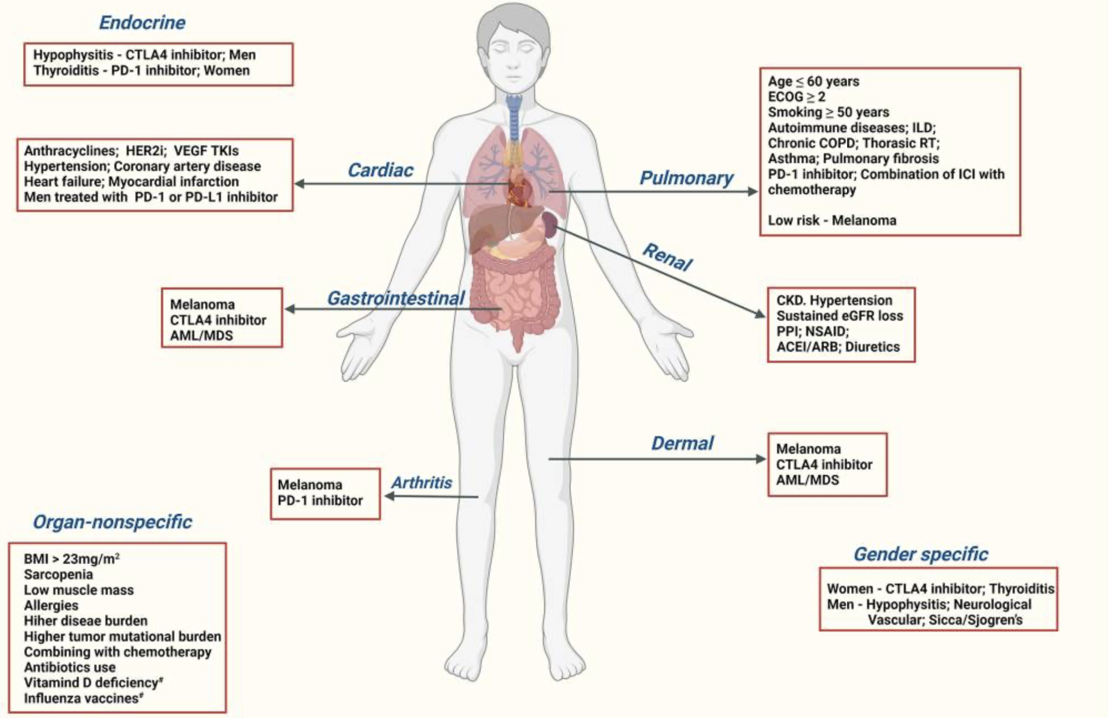
Despite there being many proposed biomarkers for irAE development, there exists a need for more reliable irAE prediction
Notes:
Chennamadhavuni A, Abushahin L, Jin N, Presley CJ, Manne A. Risk Factors and Biomarkers for Immune-Related Adverse Events: A Practical Guide to Identifying High-Risk Patients and Rechallenging Immune Checkpoint Inhibitors. Front Immunol. 2022 Apr 26;13:779691. doi: 10.3389/fimmu.2022.779691. PMID: 35558065; PMCID: PMC9086893.
External validation of biomarkers for immune-related adverse events after immune checkpoint inhibition: unable to reliably predict risk of irAEs in most cases from pre-therapy flow cytometry and clinical data
Germline variants associated with toxicity to immune checkpoint blockade: IL7 cryptic exon, IL7 supports aberrant immune activity in autoimmunity, limits organ toxicity during antiviral immune response, blocks PD-1 leading to T1D (blocking checkpoint when it would have prevented autoimmunity, so IL7 acts as a natural ICB and is therefore rationally associated with irAEs
Biomarkers of checkpoint inhibitor induced immune-related adverse events - a comprehensive review: on treatment markers including clonal expansion of more T cell clones, more newly emerging T cell clones, decline in T cell clonality all associated with more irAEs

Slide 5
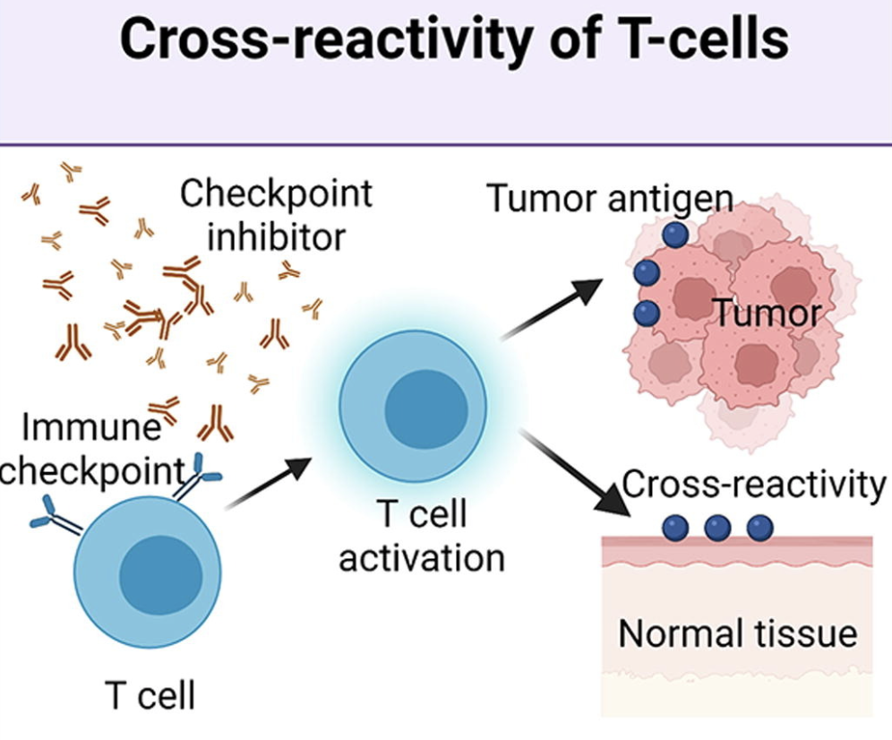
Hypothesis: crossreactive T cells may cause irAEs via reaction to both tumor and self
Supporting evidence
ICB remodels TCR repertoire
irAE development associated with T cell expansion
most similar tissue to tumor often has higher irAE incidence
dense infiltration of T cells in irAE tissue
sometimes same TCR clonotypes infiltrate tumor and irAEs
Notes:
Picture from Advanced materials for management of immune-related adverse events induced by immune checkpoint inhibitors
estimate TCRs to be able to bind ~10^5 to 10^6 peptides (Amino acid similarity accounts for T cell crossreactivity and for "holes" in the T cell repertoire)
TCR conceivably could recognize ~ 1 million peptides, crossreactive peptides likely often better agonists than original one that activated T cell, but few (~1%) of peptides are actually presented on MHC, so probably crossreactivity estimate closer to 1 in ~10,000
Association of checkpoint inhibitor-induced toxic effects with shared cancer and tissue antigens in non-small cell lung cancer:
skin second most similar to NSCLC after lung and had second highest proportion of irAEs (also Autoreactive napsin A-specific T cells are enriched in lung tumors and inflammatory lung lesions during immune checkpoint blockade)
see dense infiltration of T cells in sites of irAEs
same T cell clonotypes infiltrated both lung tumor and autoimmune skin lesions
Speculation for what crossreactive T cells are actually targeting, perhaps T cells targeting cancer neoantigens cross-react with WT version of protein in healthy tissue (Autoreactive napsin A-specific T cells are enriched in lung tumors and inflammatory lung lesions during immune checkpoint blockade)
What makes TCRs crossreactive? cross-reactivity need not result from sequence similarity (3D structural similarity more important than 1D sequence similarity (Peter’s paper: Autoreactive T cell receptors with shared germline-like α chains in type 1 diabetes)
Characterization of anti-cancer immune response associated with immune-related adverse events in patients with kidney cancer
- irAE patients had more peripheral T cell clones shared with TILs
- some irAE-provoked T cell clones circulate systemically and attack tumor cells leading to ICB response in irAE patients or vice a versa some tumor-provoked T cell clones circulate systemically and attack self leading to irAEs? not sure how they differentiate between the two
Clonal expansion of CD8 T cells in the systemic circulation precedes development of ipilimumab-induced toxicities: CD8 T cell clonal expansion was greater in patients developing severe irAEs
Effective use of latent semantic indexing and computational linguistics in biological and biomedical applications: HLA-B57 restricted T cells are more crossreactive to mutants of target epitopes, this HLA allele also associated with autoimmunity
Epitope spreading toward wild type melanocyte-lineage antigens rescues suboptimal immune checkpoint blockade response
- expansion of peripheral CD8<sup>+</sup> T cell populations specific for melanocyte antigens observed only in patients who responded to anti-PD-1 therapy, so ICI can promote breakdown of tolerance towards tumor-lineage self-antigens
- perhaps in responders with low neoantigen tumors more often will see irAEs given necessity for immune activity against tumor associated antigens shared between tumor and self
Exceptional response and multisystem autoimmune-like toxicities associated with the same T cell clone in a patient with uveal melanoma treated with immune checkpoint inhibitors
identical CD8<sup>+</sup> T cell clone found in 4 tissues in a patient with widespread irAEs (duodenum for enteritis irAE, PBMCs, original tumor and liver metastasis responses as well), evidence for crossreactivity underlying irAEs OR common antigen between tumor and self underlying irAEs
duodenitis blocked by antibody to integrin α 4 β 7 (LPAM-1) which blocks T cell infiltraton into GI tract, suggesting that GI toxicity resulted from circulating T cells trafficked to GI tract following expansion elsewhere i.e. in the tumor perhaps
Global analysis of shared T cell specificities in human non-small cell lung cancer enables HLA inference and antigen discovery: autoreactive T cells in peripheral blood may exist (pruned but not clonally deleted thymus) to avoid immunologic "blind spots" to pathogens, i.e. pathogens that look like self would get by free otherwise if we didn't have some autoreactivity perhaps
Identification of neoantigens for individualized cancer immunotherapy
cross-reactivity is possible due to low affinity of functional TCR-pMHC interaction
Heterogeneity of autoreactive CD8<sup>+</sup> T cells at sites of inflammation
shared clonal origin among CD8<sup>+</sup> T cells at site of colitis with gut T<sub>RM</sub> cells, suggesting clonal expansion from T<sub>RM</sub> population being responsible for irAEs (different from autoimmune, so for tissues that lack T<sub>RM</sub> cells, like the synovium, trafficking of T cells from the periphery may be important for irAEs)
Immune-related adverse events in various organs caused by checkpoint inhibitors
T cells seen infiltrating into irAE tissue, T cells seen targeting irAE tissue seen in blood, so T cells involved in irAEs
autoantibodies present ~50% of time for irAEs
Immune toxicities elicited by CTLA-4 blockade in cancer patients are associated with early diversification of the T cell repertoire
CTLA-4 blockade induced greater diversification of T cell repertoire (more clonotypes including newly detected clones, decreased clonality) in irAE patients compared to no irAE patients
Improved survival with T cell clonotype stability after anti-CTLA-4 treatment in cancer patients
diverse repertoires are important in limiting the magnitude of immune escape but may also promote self-reactive clones and induce host inflammation
Insight into immune profile associated with vitiligo onset and anti-tumoral response in melanoma patients receiving anti-PD-1 immunotherapy
they usually find different TCR sequences in vitiligo and primary melanoma lesions, so T cell response against normal melanocytes leading to vitiligo is not usually mediated by reactivation of T cell clones infiltrating/specific to primary melanoma but rather perhaps by T cells targeting metastatic tissues, so kind of different from my thinking of usually crossreactivity between primary tumor and irAE site but could also be crossreactivity between metastases and irAE sites
metastasis and vitiligo sample TCRs more similar than primary melanoma and vitiligo TCRs
Interpreting T cell crossreactivity through structure: implications for TCR-based cancer immunotherapy
crossreactivity driven by structural similarities of seemingly unrelated pMHCs (by sequence)
The promising link among tumor mutational burden, immune-related adverse events, and immune checkpoint inhibitors efficacy in SCLC
can see same clonotypes of T cells reactive against tumor and self in irAEs
T<sub>RM</sub> cells locally expanded in irAE-dermatitis and -colitis

Slide 6
Goal: determine if TCR (junction) features can serve a proxy for T cell cross-reactivity
Features to investigate
Junction length, chemical properties
TCR germline-ness (probability of generation)
Possible effects of feature variations
Altered TCR-pMHC contact geometry, binding modes, number of contacts
Altered diversity?
Notes:
Initially thought that more germline-like TCRs might be more cross-reactive as they have lower sequence complexity, NOT due to a more diverse repertoire and may be more likely to react with self-antigen as I tested this (diversity between top/bot pgen)…
Hydrophobicity: more hydrophobic TCRs might be more cross-reactive as they allow more alternative contacts
Entropic contributions and the influence of the hydrophobic environment in promiscuous protein-protein association: interface demonstrates promiscuity in part due to the number of interactions this hydrophobic interface allows, which allows many alternative contacts (increased entropy, drives forward binding) with other binding partners hence promiscuity
Repertoire analyses reveal T cell receptor sequence features that influence T cell fate
TRB CDR3 hydrophobicity promotes reactivity to self-peptides
Functionally specialized human CD4<sup>+</sup> T cell subsets express physiochemically distinct TCRs: longer CDR3s might promote crossreactivity

Slide 7
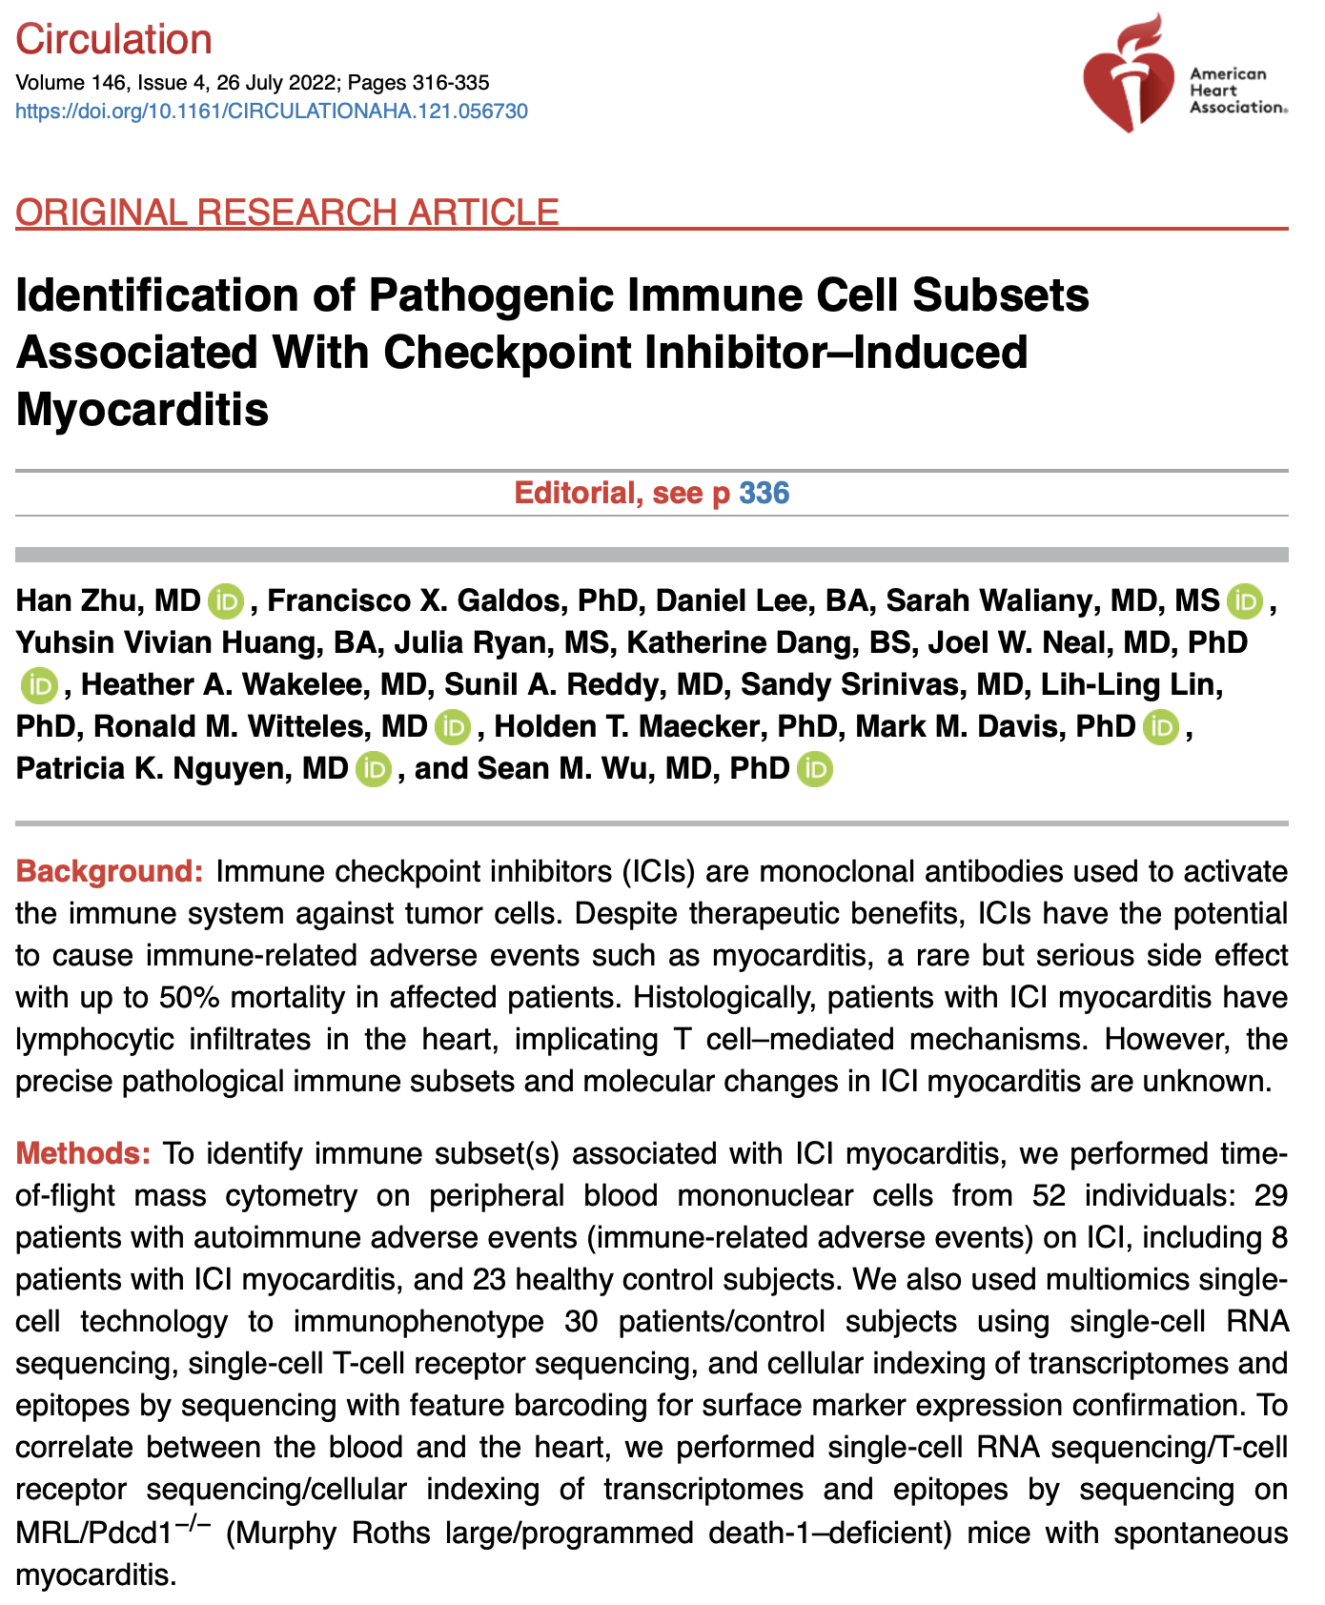
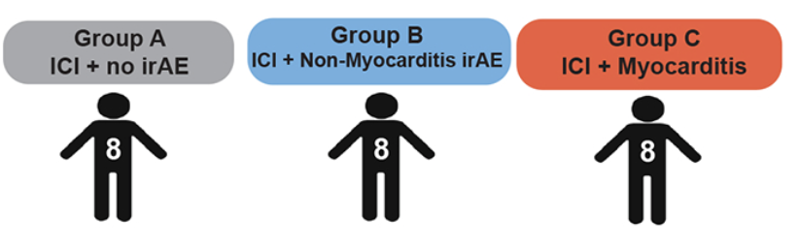
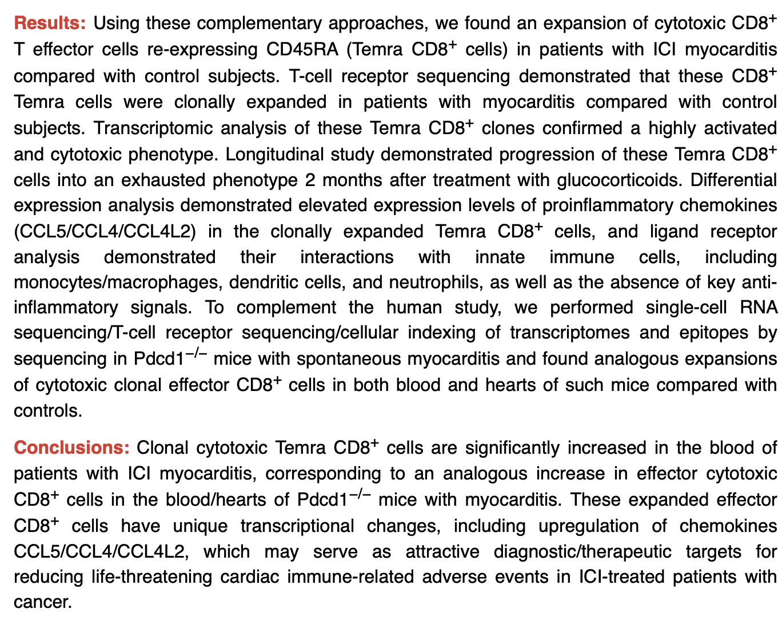
Pooled groups B & C for power
(still observe same trends if not pooled)
Notes:
Stress recency! 2022!

Slide 8
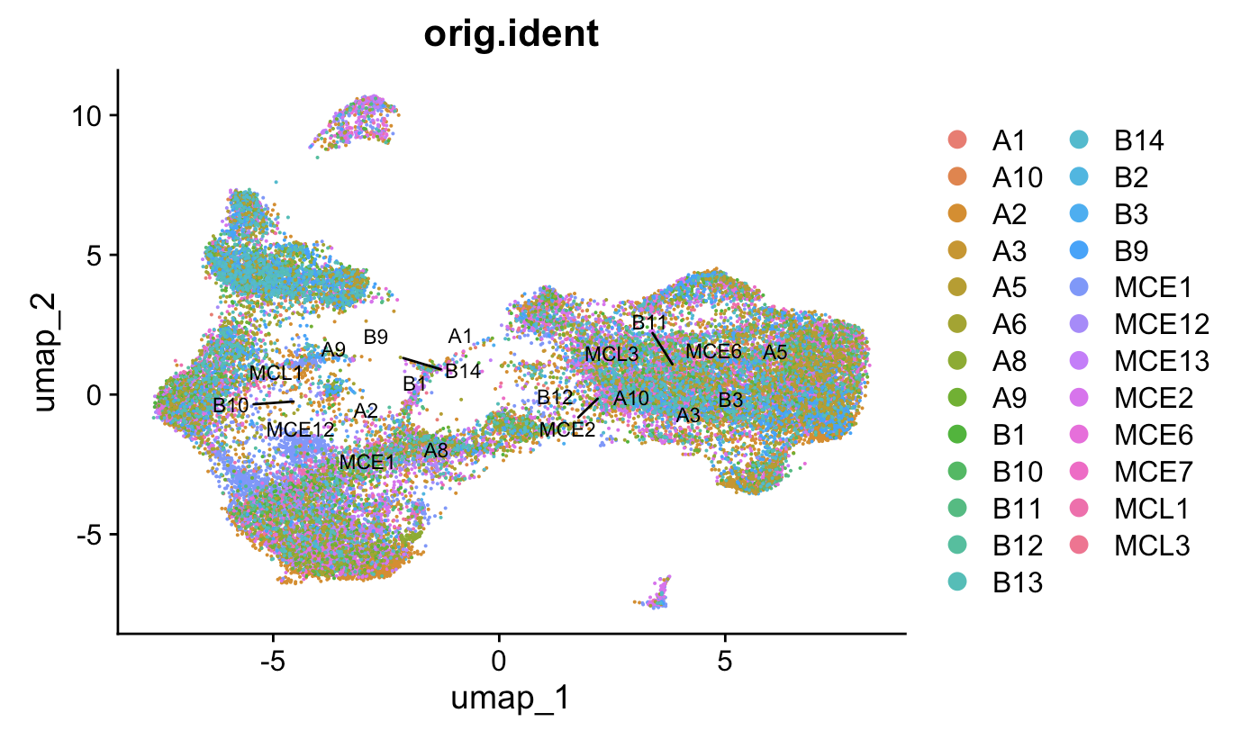
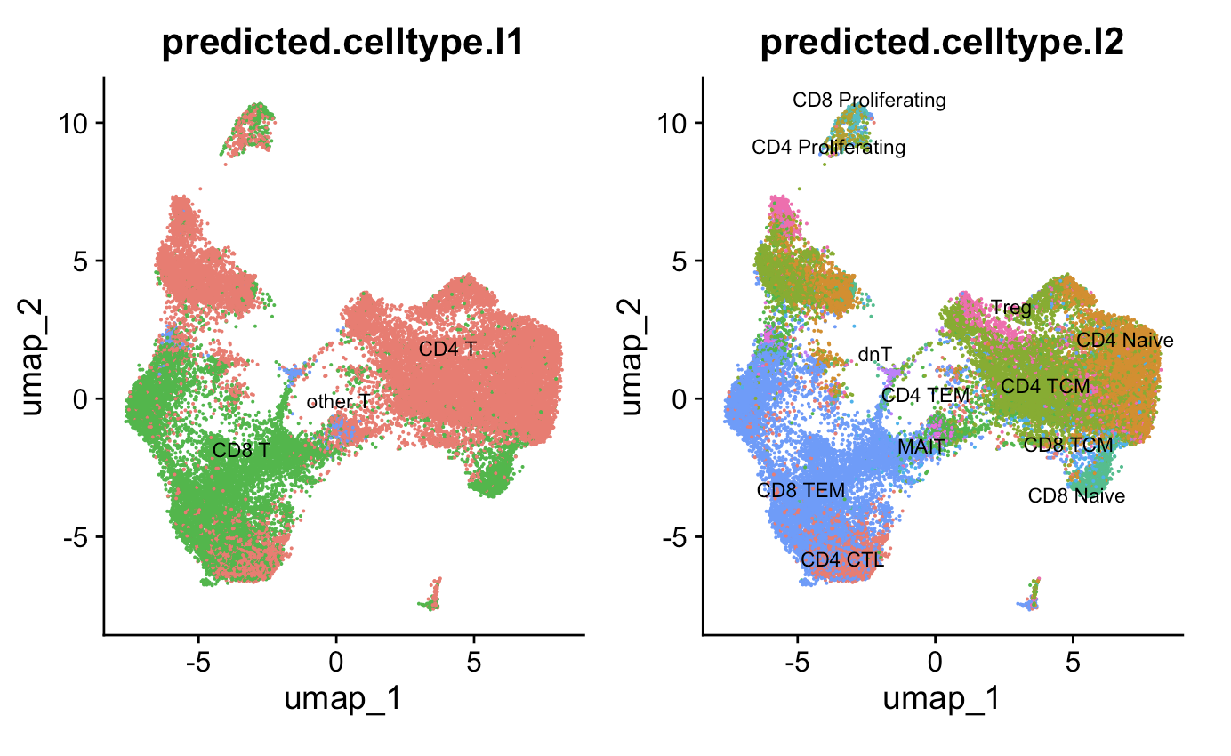
Methods
Patient ID
Quality control
Data normalization
Highly variable feature selection
Data scaling
Dimensional reduction
Clustering of cells
Reference map clusters to identify cell (sub)types
Remove non-T cells, repeat steps 5-7
Use Stitchr package to join full TCR sequences from V(D)JC and CDR3 sequences
Downsample reads per patient
CDR3 length and TCR probability of generation (pgen) analysis
Notes:
Gloss over 1-7
QC:
Mitochondrial RNA < 15%
> 500 unique RNAs/cell

Slide 9
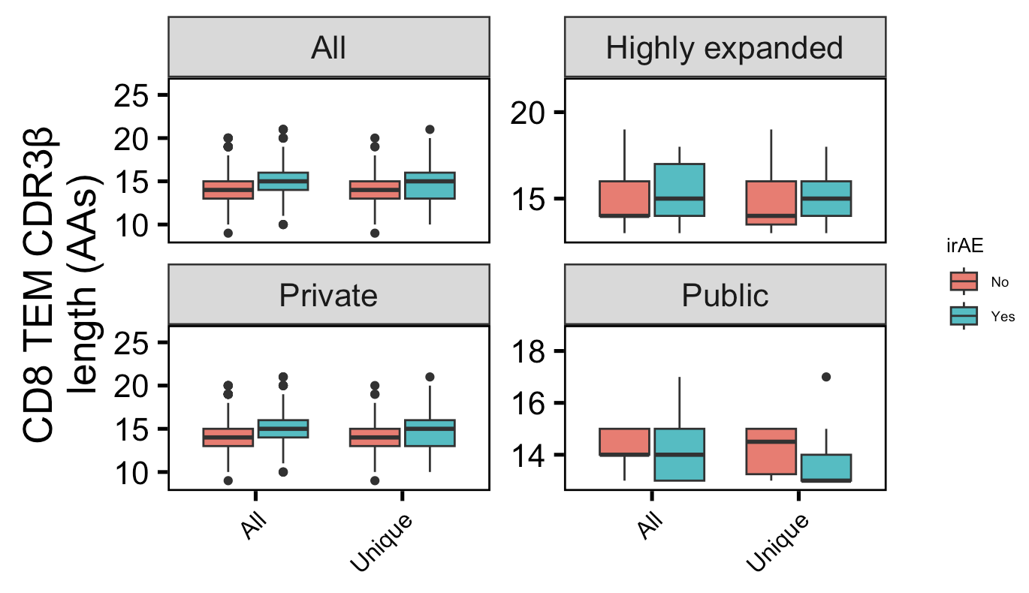
Private CD8 TEM CDRβs longer in those developing irAEs
Wilcoxon rank sum test. ****, padj <1e-4; **, padj <1e-2; *; padj <0.05
Notes:
Downsampled
only a small portion of an antigen is needed to be recognized by a TCR (8-10 amino acids for MHCI, 14-18 for MHCII, does this mean that CD8<sup>+</sup> T cells might be more cross-reactive?)
T cell repertoire analysis and metrics of diversity and clonality
CDR1-2 contact MHC and CDR3 contacts peptide is the general rule, but CDR1α also contacts peptide and CDR3β doesn't contact peptide too much
The length of the CDR3 loop greatly influences its shape and ability to fold both on itself and in the company of others loops such as the CDR1 and CDR2 (Davis et al., 1998, Wu et al., 2002): https://www.sciencedirect.com/science/article/pii/S0161589006002148?via%3Dihub

Slide 10
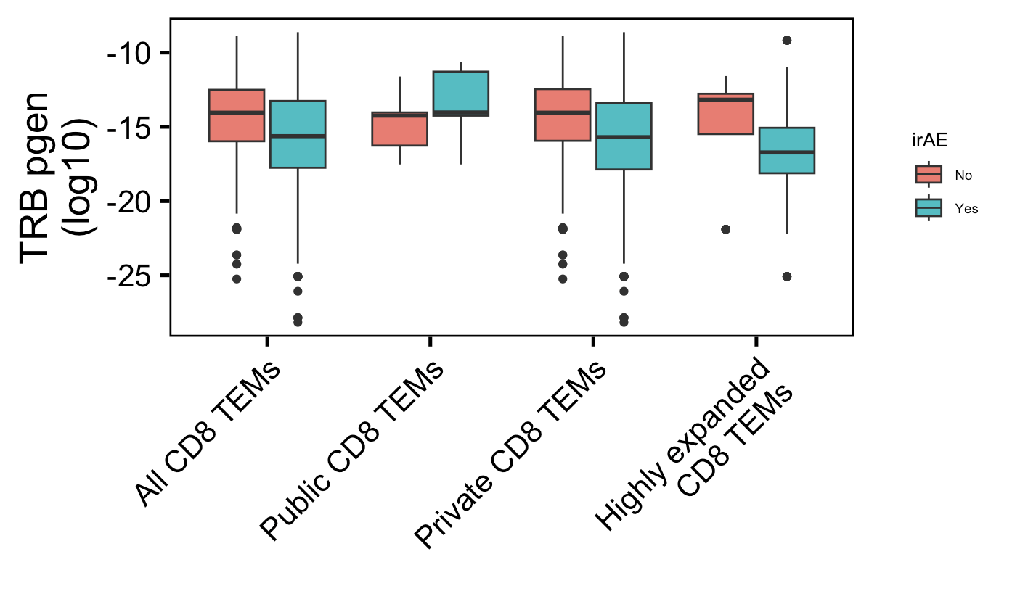
Private CD8 TEM TRBs less germline-like in those developing irAEs
****
****
n.s.
****
→
More germline-like
Less germline-like
→
n = 278
n = 816
n = 11
n = 52
n = 267
n = 764
n = 50
n = 306
Wilcoxon rank sum test. ****, padj <1e-4; **, padj <1e-2; *; padj <0.05
Notes:
Downsampled
Higher pgen generally means that it's closer to germline because the probability of mutation is lower than not mutation

Slide 11
Conclusions
longer private CDR3B CD8 TEMs and less germline-like private CD8 TEM TRBs in those developing irAEs
We can mine public data and use it in tandem with BRI data, for example using one as a training set and the other as a test set
Increased confidence in conclusions that are recapitulated across multiple datasets
Increased breadth of possible research questions to investigate

Slide 12
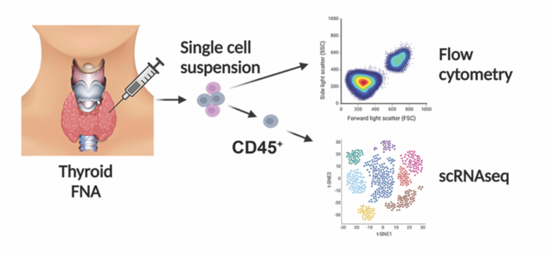
Next steps
See if findings from this dataset are recapitulated in another dataset

Slide 13
Acknowledgements

Slide 14
References

